Slide 1
Project Navigator
Regulatory & Risk Analytics (RRA)
Prepared by Seth Aslin for Essex Business School
Date: February 2014
Notes:
1

Slide 2
Presentation Outline
Background and context to Project Navigator
General project objectives
Project scope
Overall approach (and rationale)
Rapid prototyping
MATLAB-based policy simulator
Lessons learned (so far!)

Slide 3
Background / Context
2012 saw HSBC initiate a period of strategic consolidation from a commercial, operational and technical perspective
For the global risk function, Regulatory Risk and Analytics, this has meant:
a stronger focus at the centre of the organisation in London, coordinating risk-related projects in multiple countries and within multiple regulatory jurisdictions
Increasing the level of standardisation across risk methodologies, technologies, governance formats and data models
WCMR / RRA has an objective to improve the ‘consistency’ of the global rating system and has embarked on a programme of system-wide change to achieve this consistency
Several separate projects contribute to the Consistency Programme – Project Navigator is one such initiative
Project Navigator is focused on improving rating assignment – the process of selecting the appropriate ‘path’ for a rating to take through the various models and rating modifiers that comprise the overall rating system

Slide 4
Tactical Heat Map for Project Navigator
RRA ENTERPRISE ARCHITECTURE (Wholesale Credit)
Credit Approval Workflow Engine
RATING PLATFORM
DATA
Systemic Risk Measurement
Stress Testing
Development
Obligor Data +
Capture
Relationship Management
Model Selection Process
Model Engine
Calibration Engine
Parental Support Framework
Validation
Model Landscape
PD Models
CAL Solution
Sovereign Ceiling
CRR / PD Outputs
Rating Process
LGD Models
HSBC MRS
Legal and Risk Hierarchies
EAD Models
Rating Phil.
Sovereign Support
Rating Meta-Data
Credit Approval Processes
Entity Identifiers
Monitoring / Model Management
Override Process
Account Data
Model Policies and Standards and Governance Processes
Data Policy
Credit Policy / FIM
Development Planning and Management
Validation Planning / Mgt
Data Models
Credit Risk Strategy
Development Process
Calibration Process
Validation Process
Rating Process Design
Development Resources
Calibration Resources
Validation Resources

Slide 5
Project Objectives
The project’s high level objectives are:
To formalise and improve the logic used in determining a given wholesale rating’s assignment strategy, including the effects of any rating modifiers, towards the final rating;
To automate this logic via algorithms embedded in the banks primary rating systems

Slide 6
Project Scope
The following aspects of the rating system are in scope:
Rating assignment strategy – the overall strategy that determined the basis for a rating, including any models, modifiers, etc used in the determination of the rating
Rating Model Selection – the process of objectively selecting a model to rate an obligor based on (1) the borrower’s attributes and (2) the collective scope set of the current PD models
Parental Support Framework (the ‘PSF’) – the replacement of a stand-alone rating with a parent’s rating (or notched derivation)
Sovereign Ceilings – the application of a ceiling to obligor ratings due to (principally) transfer and convertibility risk (‘T&C’ risk)
Risk Hierarchies/Networks – recognising the effects of control, and economic interdependency, through networks of relationships
Rating event audit trails – implementing an information rich body of meta-data that captures and accurately reflects all of the attributes, decisions and thresholds that led to the final rating

Slide 7
Overall Project Approach
Solve all related problems within the same cycle (= ‘anything to do with rating assignment’)
Form a cross-functional team from Credit Strategy, Policy, Analytics, Technology
Project attributes:
High complexity (especially in the interaction between components)
Unknown levels of regionally-based variation in requirements and regulatory constraints
Rapid changes anticipated throughout project
Aggressive timelines set by senior management
Our conclusion: use a simulator … a policy simulator … in a rapid prototyping mode
A simulator implies coding … but what sort of code exactly?
In what language?
With what structure?
Developed in what environment?

Slide 8
‘Rapid Prototyping’ (RP)
Complementary to other conceptual frameworks (RAD, Lean, DES, Agile, TDD, CAD/CAE, etc)
Most business problems are amenable to this family of techniques
Many ways to characterise RP (next slide)
Our approach: highly abstract, virtual prototype (in object-oriented code), for design + problem solving
All development characterised by fast, short, exploratory cycles
Abstraction is key – strip away all extraneous content, find the ‘essential core’ of the problem
Use of high level languages is key
Rapid iteration through solutions – short cycles are key for some modes of RP
Data:
Empirical
Experimental
Synthetic

Slide 9
Categorising / Characterising RP
Purpose:
Exploring ideas
Design / design validation
Problem-solving
Requirements-gathering / product specification
Consensus-building
Time/cost estimation, time/cost reduction
Parameter-approximation
…etc etc
Degree of abstraction
High abstraction: reduction of detail and domain content, emphasis on mathematical aspects, increased use of symbolic formalisms, or selective subset simulation
Low abstraction: = ‘high fidelity’, the prototype is highly representative of the final system or product, and/or covers a full system
Form (/Medium):
Physical prototypes
Virtual / soft prototypes

Slide 10
What is a ‘Prototype’?
Informally, there are many related terms:
Simulation
Mock-up
Proof-of-concept
Trial
Pilot
Model
Micro world
Scenario engine
Working definition of a prototype (or prototype equivalent):
An abstraction of a real world system, object or phenomenon…
…that is cheaper and faster to construct than its real-world counterpart…
…and whose form, functionality and attributes…
…can support a wide range of management processes…
…and whose most fundamental effect is to reduce risk and accelerate organisational learning

Slide 11
Advantages of the Rapid Prototyping approach
Test a large number of concepts, options, strategies and configurations at:
…very (or relatively) high speed and/or at
…very (or relatively) low cost
Virtual prototypes are a platform for using more advanced approaches to problem solving and design (e.g. evolutionary programming)
Uncover problems in design / improve design early in a project
Capture requirements and manage key trade-offs in a sophisticated, integrated manner
Build consensus and create shared mental models on key issues
Help a broad (non-technical) audience to visualise an idea, a problem, or a projected outcome
Socialise an issue (then crowd-source the solution)
Manage complexity – uncover dependencies, unusual dynamics, ‘emergent properties’
Reduce the risk of making a catastrophic decision

Slide 12
Abstraction
Selecting a level of fidelity that suits the purpose of the prototype, and stays inside the ‘envelope’
Multiple formalisms involved:
Narrative policy
Flow charts
Rule sets
Propositional logic / calculus
Linguistic formats (if/then…)
Conversion (translation) process is a critical aspect
Setting system boundaries
Short cycles are essential to maximise RP yield

Slide 13
Data Required (General)
The data used within the project is a mix of (1) synthetic and (2) actual
Synthetic cases will be designed to systematically test assumptions and critical points in the proposed solution
These cases may be generated using a statistical technique that is designed to ‘exhaust’ all of the main permutations and dimensions of a problem
Some level of actual data (cases) will be captured because:
They symbolise or represent specific, benchmark cases to key stakeholders
They are known to be problematic cases that are difficult to resolve algorithmically
They highlight known vulnerabilities in the current system
They symbolise or highlight an ambiguity in policy and/or strategy

Slide 14
Considerations Particular to Navigator
Points to consider:
modular-but-interrelated nature of the core problems…
unknown location of final solution(s)…
the requirement to conceive, implement and test certain algorithms…
a need to somehow process a large number of policy ideas (rating scenarios)…
the need to visualise results quickly and easily…
the need for several people to work on the problem simultaneously, passing fragments of code around and then integrating them into the simulator…
plus a maintainability burden due to high levels of changes within the project…
… all implied that (1) an object-oriented approach in (2) an interpreted environment would be ideal
MATLAB in its object-oriented mode is almost perfectly designed for this sort of work

Slide 15
De-romanticising the Development Process
Traditional (idealised) development cycle:…
Business problem identified
High level solutions generated
Formal requirements elicited
Functional specification drafted
Development
Internal testing
User Acceptance Testing (UAT)
Release to production
…and what can happen in practice:
Identify business problem
High level solutions generated
Formal requirements elicited
Functional specification drafted
Development
… logical problems in business concept uncovered
… minor/major revisions to key concepts
... re-commencement of development
Internal testing
User Acceptance Testing (UAT)
… further concept revisions arising from UAT
… remedial development work
… additional (hopefully final) round of UAT
Release to production
… bugs identified from the live environment
… remedial programming
… re-release

Slide 16
High-Level Structure of Problem Solving Process
Identify issues (central themes, specific problems, etc)
Frame issues as rating scenarios requiring a formal resolution
Examine and set the HSBC ‘house view’ on key issues
Define the solution for each rating scenario (potentially involving a wider group of stakeholders)
Convert rating scenarios into benchmark test cases and/or map them on to actual cases
Generate an array of additional test cases to probe solution boundaries
Code the solutions into the simulator (directly altering modules to reflect solutions, policies, etc)
Run the test cases through the simulator, collate
Review strategies and solutions

Slide 17
Central Work Cycle
Project Scope
Key Scenarios
Issues List
Test Cases
Candidate Solutions
Classes
Simulator
Key Results (per case):
CRRs
Rating ‘path’
Intermediate states
Active Components (Objects):
Obligor object
Model landscape object (collective scope set)
Rating model selection (RMS)
Parental Support Framework (PSF)
Sovereign Ceiling (SC)
Effective Risk Hierarchy / Network (ERH) object
Results
Conclusions
Selected Solutions
Resolved Scenarios
High-Level Requirements
Functional Specification
Policy Changes

Slide 18
Simulator: Operating Modes
‘DOE’
Object-based code library
Script
Excel
Distribution Analysis
Monte Carlo
N
ΔRWA%
Single Cases
GUI
Dash
Case Review
‘Q-Space’
RWA Engine

Slide 19
Class Library Overview

Slide 20
Navigator Class Library
Relatively large number of classes given the number of sub-problems involved
High levels encapsulation of every functional aspect of the Navigator project
Namespaces (packages) and class folders used to organise code
Methods written to keep the ‘public interface’ as clean / standard / logical as possible
Delegation principle followed to keep the classes as loosely coupled as possible
Collections of objects used for managing the rating model selection problem
Classes become natural ‘locations’ or ‘hooks’ for key algorithms (e.g. classification, matching, etc)
‘Composition’ based relationships fairly common (very little ‘inheritance’ at this stage)
Boundary elements (classes) are mock objects for future interfaces, and points of integration

Slide 21
Visual Scenario Template

Slide 22
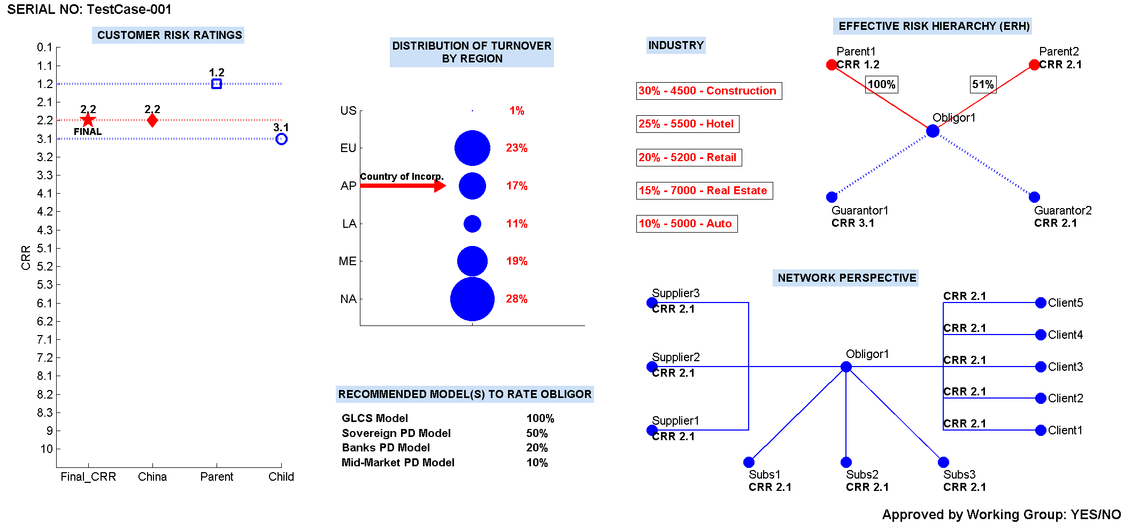
Test case 001 (example only)

Slide 23
Lessons Learned
High level languages are brilliant prototyping environments – especially for non-programmers!
Scripting is seductive but the discipline of classes/objects is worth the effort
Class libraries are time-consuming to create in the first place but the modular structure has already shown benefits
MATLAB’s object-oriented syntax is clean, simple and easy to understand
We have found pure ‘test driven development’ (TDD) to be a challenging approach to maintain in the face of (very) high ambiguity and (rapidly) changing requirements
We prefer a sort of loose, informal prototyping that proceeds from idea → scripts & functions → script-facilitated classes → classes wrapped in a GUI-managed session (a quasi-app)
We’ve learned through experience to integrate as continuously as possible
GUIs are extremely simple to code in MATLAB – we recommend building GUIs for any repetitive task (and make the decision early to build them)
Important to position the prototype correctly in people’s minds and to manage organisational dynamics that surround it

Slide 24
Closing Points
RP is not just for engineering problems!
RP has broad utility for framing and solving problems, as well as facilitating decision making
Be open to learning some of the formalisms that are more associated with mathematics (and modelling in general)
Learn to code!
Even small problems have a lot of hidden complexity – simulation / RP can uncover these
Become familiar with patterns of risk inside projects, and conversant in the methods that have proven to manage these risks

