Slide 1
The Big Challenge:
Trading Models
Richard Olsen

Slide 2
Overview
What is the right approach to building trading models?
Understanding the nature of time
The power of scaling laws
Lego building blocks for development of financial engines
The vision: platform similar to Foldit
What needs to be done.

Slide 3
Personal Background
Studied law at University of Zurich, Economics at Oxford, PhD in law, Title: Interaction Between Law And Society.
Worked in a bank in research department and as a trader
Founded Olsen & Associates in 1985, collect tick-by-tick foreign exchange data as of 1986, develop a real-time. information system with forecasts of price and volatility, trading recommendations and other analytics.
Discovery of scaling law of absolute price changes in 1989, first conference on high frequency finance in 1995, discovery of scaling law of number of directional changes in 1997.

Slide 4
Personal Background
Co-founded OANDA in 1996, introduced currency converter, launched a trading platform in 2001 with second-by-second interest rate payments, leading FX market maker
Essex University Visiting Professor from 2008
Discovery of 12 new scaling laws in 2008, published in journal of quantitative finance, see also http://arxiv.org/abs/0809.1040
Hands on experience of running a hedge fund

Slide 5
Personal Motivation
Inspired by progress in medicine and computer technology to innovate in finance.
Not afraid to start afresh.
Bottom-up approach to economics, begin with collecting tick-by-tick data and proceed iteratively.
Financial markets are not a zero-sum game; they are an integral part of real economy.
I view financial markets as a source of energy: risk/return ratio is 1 to 25 (one year coastline is 1600% after transaction costs compared to price risk of 30%).

Slide 6
How Have Managers Performed?

Slide 7
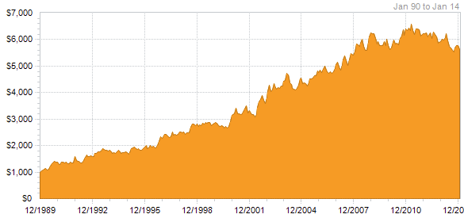
NAV of 40 Leading Futures Managers
Year or YTD Return
2014 -2.61 %
2013 -2.45 %
2012 -4.75 %
2011 -3.23 %
2010 11.33 %
2009 -7.98 %
2008 15.47 %
2007 7.18 %
2006 6.70 %
2005 4.51 %
2004 2.57 %
Altegris 40 Index sm
Disappointing performance…

Slide 8
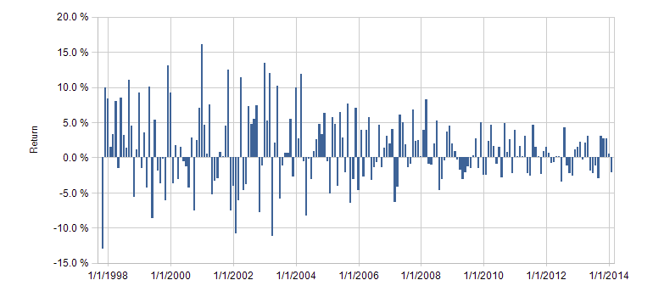
Winton Performance
Winton has 25 billion of assets under management.

Slide 9
Trading Strategies Of Quant Fund
Directional trading:
  Fundamental systems
  Universal systems
Intraday models
Equity statistical arbitrage:
  Technical strategies
  Fundamental strategies
Volatility arbitrage
Directional volatility
Only 1.5 percent performance for 2013

Slide 10
Technical Trading Terminology
Overall trend
Support
Resistance
Momentum
Buying/Selling pressure
Relative Strength
  Strength of the current trend
  Maturity or stage of current trend
  Reward to risk ratio of a new position
  Potential entry levels for new long position
  Fundamental systems

Slide 11
Weakness of Technical Analysis
Analyst bias
Open to interpretation
Too late
Always another level
Trader’s remorse

Slide 12
Fundamental Analysis
Economic analysis
Industry analysis
Company analysis
Buy and hold investors
Contrarian investors
Value investors

Slide 13
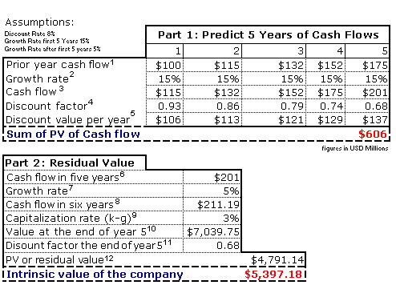
Fundamental Valuation Example

Slide 14
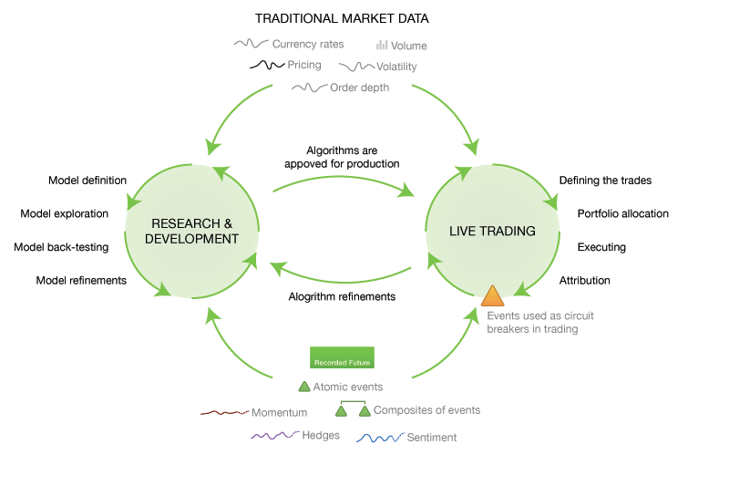
How Practitioners Develop Models?
Thanks to Predictive Signals Corp.

Slide 15
We Need To Ask Questions
1600% annual coastline after transaction cost per instrument – huge profit potential…
Traders can offset and net risk…
Markets are a part of real economy.
Modern technology works, because methods are subtle?
Nature is subtle....
Are financial models sufficiently subtle?

Slide 16
What Is Recipe Of Nature?
Structure
Variation

Slide 17
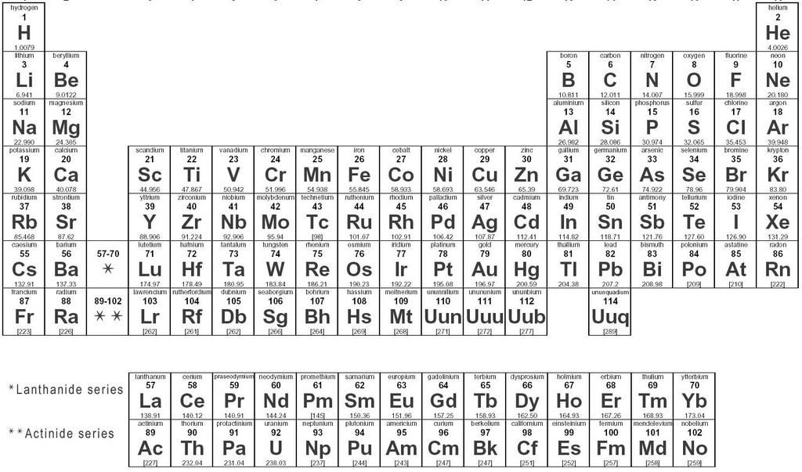
Chemical Table

Slide 18
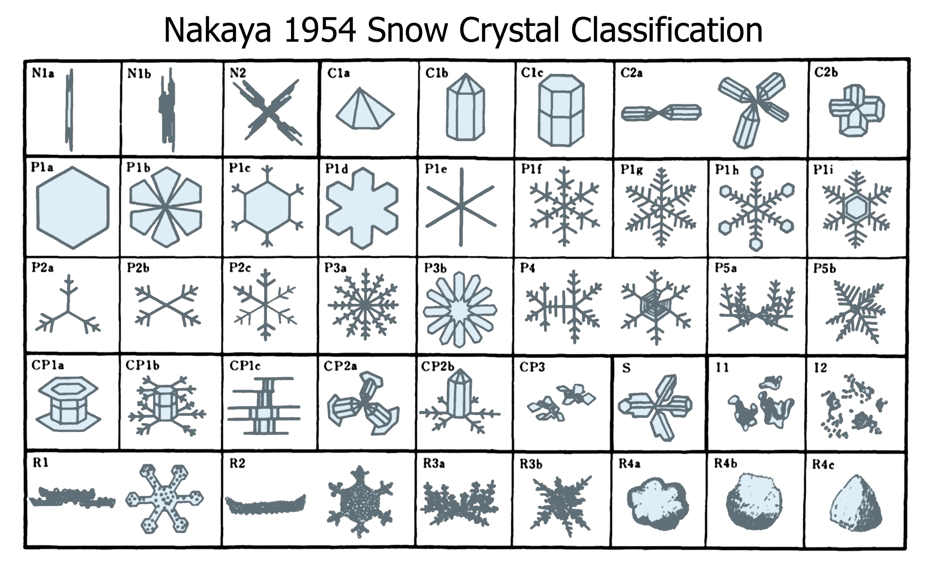

Slide 19
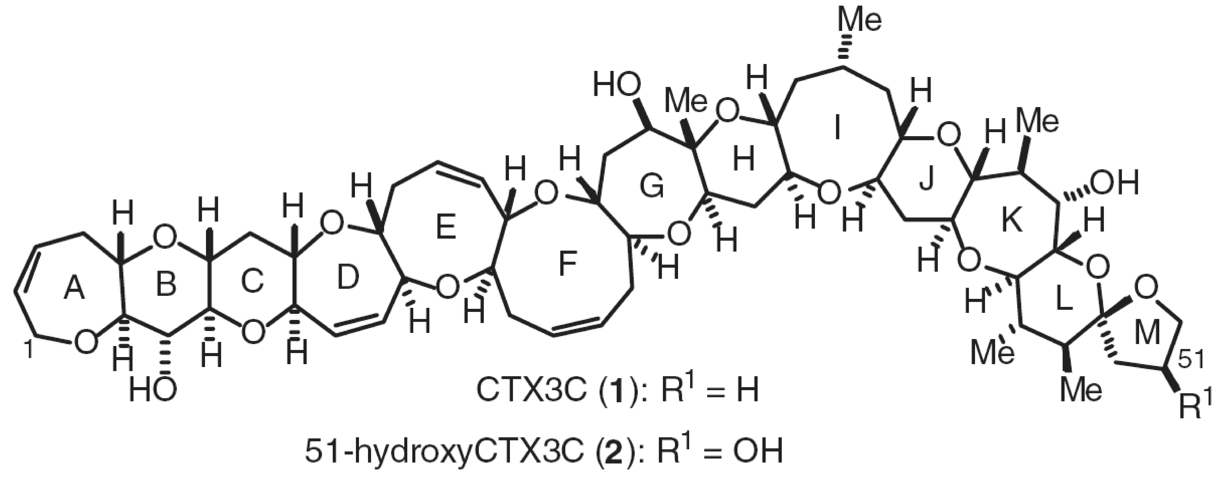
Complex Molecules

Slide 20
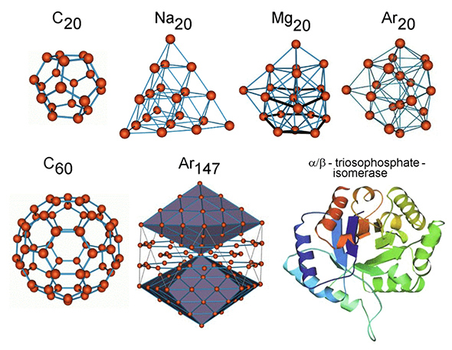
Structure and Variation

Slide 21
Lets start…

Slide 22
Our Recipe
Introduce event based definition of time
Grid of scaling laws as a frame of reference
Create a development and simulation platform similar to ‘Foldit’ to discover large diversity of trading atoms that can be turned into a strong investment strategy.

Slide 23
Time

Slide 24
Time Series Analysis Involves Sampling
Population
Sample
Correct sampling method is important for success!

Slide 25
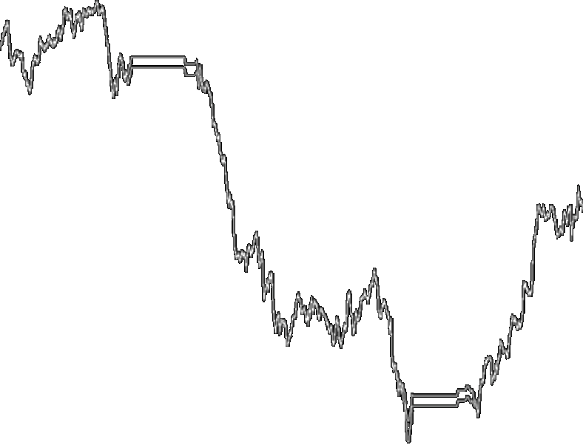
How To Sample A Time Series?
Tick-by-tick?
Every second?
Every minute, hour, day, week, month…data?
How to interpolate, if no data is available?

Slide 26
Sampling Data In Physical Time
Physical time is not dynamic and does not capture information of extremes.

Slide 27
If We Increase Sampling Frequency?
Increasing frequency of
sampling adds noise.

Slide 28
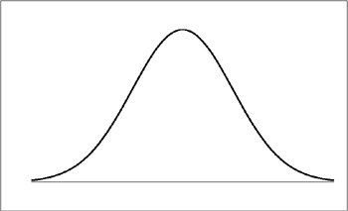
Increased Sampling Reduces Signal Quality
Data collected within time interval:
Noise
Signal
Basic problem: information is in tails.
Signal to noise ratio deteriorates with increased sampling.
Issue: Signal is conditional to specific cutoff times.
This raises the question what is time?

Slide 29
Conjecture
There is no abstract time.
Time tracks the identity of a particular system and records the events of interaction with other systems.

Slide 30
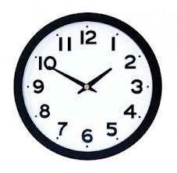
Physical Time
Physical time maps the rotation of the earth.
It is a uniform scale: X = (X_1, X_2, X_3 …. )
Events have equal weights.
There are fixed equi-distant time intervals of 1 minute, 1 hour, 1 day, 1 week….

Slide 31
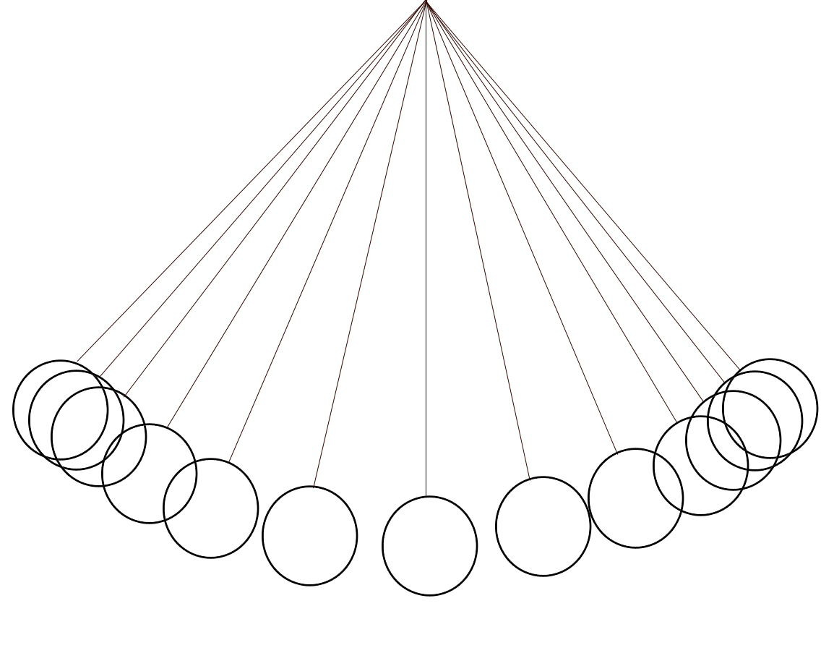
Pendulum
Pendulum triggers time events in clock.

Slide 32
Actual Time Series
Discrete events, not continuous
Intervals are not equally spaced.
Volumes are spurious.

Slide 33
Definition Of Event Time
An event is a price reversal or excursion of x percent from a local price extreme as defined by the observer.

Slide 34
Illustration Of A D-Event
A t-event is defined as a price reversal from local extreme by x %.
In our papers we call a price reversal a directional change.

Slide 35
Price Overshoot
Size of overshoot between events.
Events are separated by so-called ‘overshoots’.

Slide 36
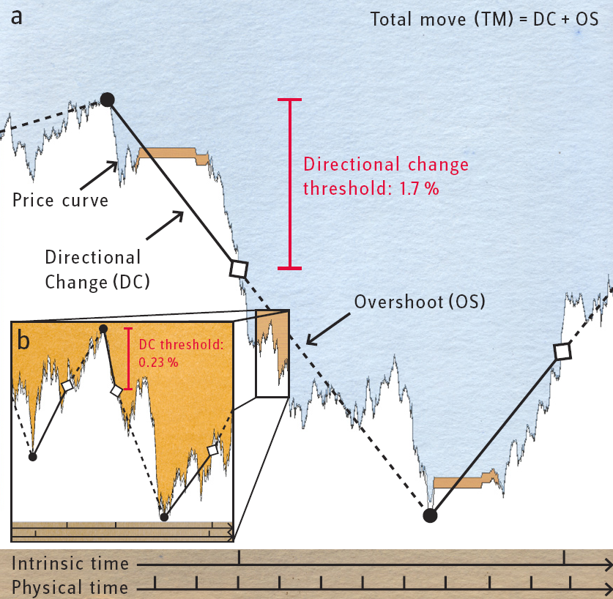
Schemata Of D-Event Time

Slide 37
How Big Is An Overshoot On Average?
?

Slide 38
Empirical Evidence
Valuable ex ante information
Overshoots are on average equal to threshold;
this is true for all observed thresholds.

Slide 39
Benefit Of Event Time
In calendar time the outcome of an analysis depends on the exact starting time; in event time extremes are the pointers and bring event time into sync whatever the exact starting point.

Slide 40
Physical And Intrinsic Time
Physical time
e.g. [hours]
1
2
3
4
5
6
−Δx
−Δx
Δx
Δx
Intrinsic time
[events]
1
2
3
4

Slide 41
Uncertainty Principle
Physical time
e.g. [hours]
1
2
3
4
5
6
Uncertainty at higher resolution
−Δx
−Δx
Δx
Δx
Intrinsic time
[events]
1
2
3
4
Dynamic uncertainty with drift information....

Slide 42
A Grid Of Scaling Laws

Slide 43
Trading Models Are Engines
Trading models consist of trading cells
Each trading cell is a small engine.
An engine has levers, gear shifts, breaks, etc.
Engines are ‘virtual’ and only exist in the abstract world of bits and bytes, except for the actual transaction of buying and selling.
How do we design levers?

Slide 44
Scaling Law As A Lever
Property Y
Scaling Law
Event Operator: X
The scaling laws are the levers that ensure consistent mapping of events in X to property Y.
Estimation of scaling law exponents is data efficient and can be updated on an ongoing basis.
We can build a grid of scaling laws to create a comprehensive and dynamic framework to trigger actions.

Slide 45
Tick-count scaling law
Notes:
\langle \textsf{N} (\Delta x_{tck}) \rangle = \left( \frac{\Delta x} {C_{\textsf{\tiny N},tck}} \right)^{E_{\textsf{\tiny N},tck}} \quad\textrm{where} \, \Delta x_{tck}=0.02\%

Slide 46
Other Questions
Average number of small directional changes within a big directional change
Average yearly number of price moves
Average maximal price move during time interval
Average duration of a price move
Average duration of a directional change
Average length of the coastline and its components
Discovery of new 12 scaling laws.
Notes:
\textsf{N} (\Delta x) = \left( \frac{ \Delta x} { C_{\textsf{\tiny N},x} } \right)^{E_{\textsf{\tiny N},x}}
\langle \Delta x_{m} \rangle_p = \left( \frac{\Delta t}{C_{m}(p)} \right)^{E_{m}(p)}
\langle \Delta t_x \rangle = \left( \frac{\Delta x}{C_{t,x}} \right)^{E_{t,x}}
\langle \Delta t_{dc} \rangle = \left( \frac{\Delta x_{dc}}{C_{t,dc}}\right)^{E_{t,dc}}

Slide 47
Established scaling laws
Müller et al., J. Bank Finance, 1990:
Mean absolute change of mid-price to time
Guillaume et al., Finance Stoch. 1997:
Number of directional changes to thresholds
Notes:
\langle |\Delta x | \rangle_p = \left( \frac{ \Delta t } { C_x (p)} \right)^{E_x (p)} \; \textrm{where} \; \langle x \rangle_p = \left( 1/n \sum_{j=1}^n x_{j}^p \right)^{1/p} \, p=\{1;2\} 24
\textsf{N} (\Delta x_{dc}) = \left( \frac{ \Delta x_{dc}}{ C_{\textsf{\tiny N},dc} } \right)^{E_{\textsf{\tiny N},dc}}

Slide 48
Other Scaling Laws
2. Average yearly number of price moves
3. Average maximal price move during a time interval
4. Average duration of a price move
5. Average duration of a directional change
Notes:
\textsf{N} (\Delta x) = \left( \frac{ \Delta x} { C_{\textsf{\tiny N},x} } \right)^{E_{\textsf{\tiny N},x}}
\langle \Delta x_{m} \rangle_p = \left( \frac{\Delta t}{C_{m}(p)} \right)^{E_{m}(p)}
\langle \Delta t_x \rangle = \left( \frac{\Delta x}{C_{t,x}} \right)^{E_{t,x}}
\langle \Delta t_{dc} \rangle = \left( \frac{\Delta x_{dc}}{C_{t,dc}}\right)^{E_{t,dc}}

Slide 49
More Scaling Laws
Decomposition of total price move into directional-change and overshoot
6-14. Leads to 9 additional scaling laws
Notes:
\langle | \Delta x^{tm} |\rangle &=& \langle | \Delta x^{dc} |\rangle + \langle | \Delta x^{os} |\rangle , \\\langle \Delta t^{tm} \rangle &=& \langle \Delta t^{dc} \rangle + \langle \Delta t^{os} \rangle, \\\langle \textsf{N}( \Delta x^{tm}_{tck}) \rangle & =& \langle \textsf{N}( \Delta x^{dc}_{tck}) \rangle + \langle \textsf{N} (\Delta x^{os}_{tck})\rangle
\label{slcondx1}\langle | \Delta x^* |\rangle &=& \left( \frac{{\Delta x}_{dc}}{C_{x,*}} \right)^{E_{x,*}} \\\label{slcondx2}\langle \Delta t^* \rangle &=& \left( \frac{{\Delta x}_{dc}}{C_{t,*}} \right)^{E_{t,*}} \\\label{slcondx3}\langle \textsf{N}( \Delta x^{*}_{tck}) \rangle &=& \left( \frac{{\Delta x}_{dc}}{C_{\textsf{\tiny N},*}} \right)^{E_{\textsf{\tiny N},*}}

Slide 50
More Scaling Laws
15-17. Cumulative price moves
We find 12 independent new scaling laws.
Notes:
\Delta x_{cum}^* & = & \sum_{i=1}^n | \Delta x_i^{*} | \\& = & \left( \frac{{\Delta x}_{dc}}{C_{cum,*}} \right)^{E_{cum,*}}

Slide 51
A Grid of 12 Scaling Laws

Slide 52
Any Number Of Scaling Laws?
Property Y
Observed Scaling Law
Central Limit Theorem
Event Operator: X
Conjecture 1: due to central limit theorem output of property y conditional to event filter X is a scaling law.

Slide 53
Events Are Units Of Measurement
4
Excursion
3
2
Event
1
The events are the natural units to measure the size of excursions; the time points of actions are set in terms of event units.

Slide 54
Code Language
4
Wait…
Wait…
Excursion
3
Go short 0.25
2
Go short 0.25
1
Wait…
Event
Atoms follow different decision rules….: big diversity!

Slide 55
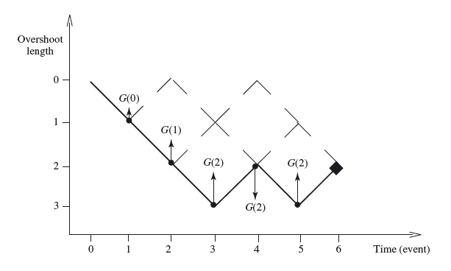
Trading The Coast Line

Slide 56
Why We Need Diversity?
Big risk in trading is to be trapped in big price move…
We need diversity with a huge number of cell-traders.
By analogy: human body has about 100 trillion cells.

Slide 57
FX Market Structure
ECNs
Large
Banks
Retail
Traders
Interbank
$2’000B+/Day
Institutionals
approx 3000
FCMs

Slide 58
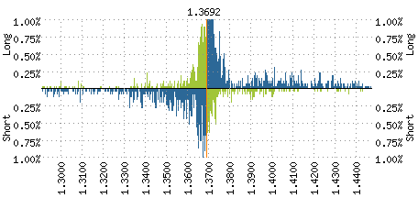
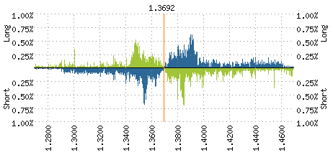
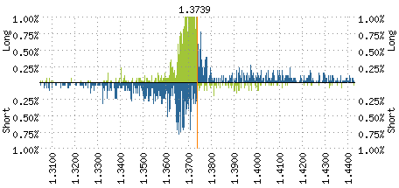
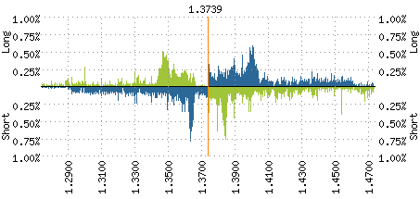
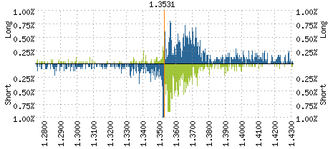
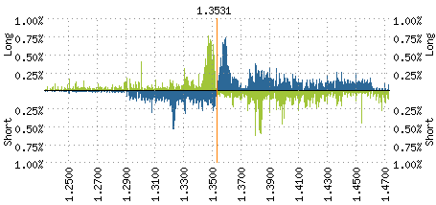
Position Information
Positions
Orders
Jan 9, 2009 12.30
Jan 9, 2009 12.30
Jan 9, 2009 13.30
Jan 9, 2009 13.30
Jan 9, 2009 14.30
Jan 9, 2009 14.30
Complimentary OANDA service, see http://fxlabs.oanda.com

Slide 59
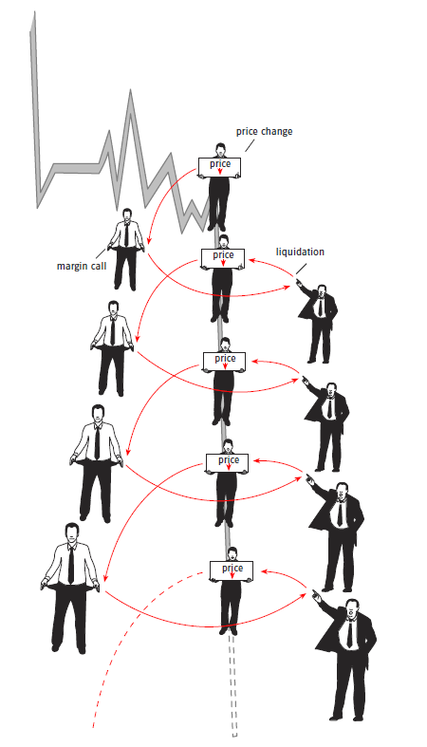
Margin calls trigger price cascades
price change
liquidations
margin call
Large price trends are the result of
cascading margin calls.
Example: recent EUR upmove
is result of everyone getting it
wrong....

Slide 60
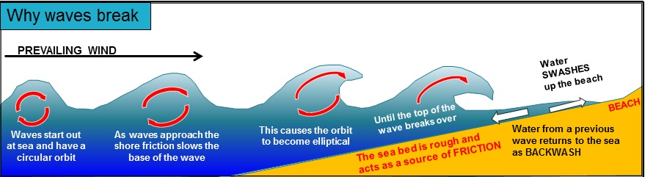
Analogy To Oceonography
alohasuurfinguide.com

Slide 61
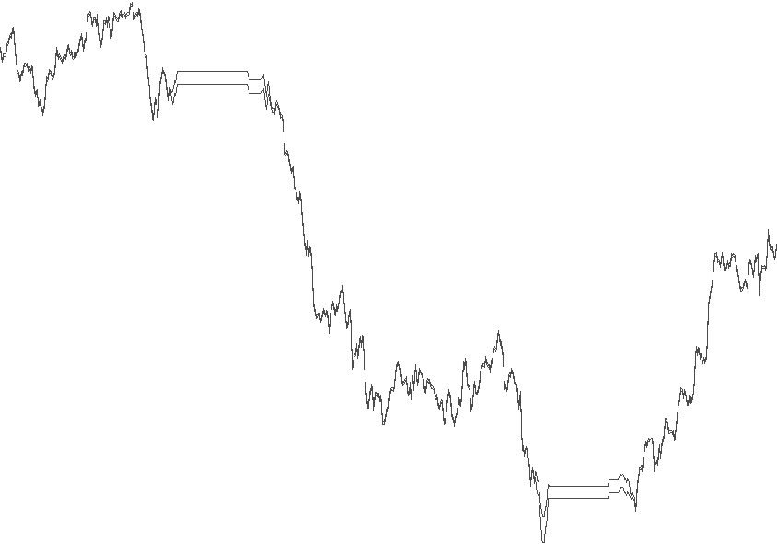
Diversification Of Trading Cells
Unique
Original Price Curve
Threshold 0.8%
Price
Physical Time
Directional Change
Overshoot
DC
1. Overshoot
OS
Threshold
Price
Event Time
Threshold 0.2%
Threshold 0.4%
Intrinsic Time

Slide 62
Coastline Trading
Open
Managing
Extrema
Directional
Change
Overshoot
Average
Exposure
Coastline Trading
Take Profit
Information
Take Profit
The threshold of 1% is only an example threshold.
Same methodology applies to short position.
Price curves are discrete and not continuous as in the illustrations.
Several positions are trading at a given time.
1%
1%

Slide 63
Interacting Cells Trade The Coastline
long trade
short trade
close long
1
1
close short
coastline trading
2
1
1
2
2
1
2
1
3
1
3
3
1
2
1
1
1
1
2
2
2
1
1
3
2
1
3
3
1
2
Each number corresponds to an independent trading agent.
2
2
open long
open short
increase long
open long
open short
open short
take profit short
take profit short
increase long
increase short
coastline trading
take profit short
take profit long
take profit long
1 gets advantage
1 gets advantage

Slide 64
Complex decision trees

Slide 65

Platform To Develop Trading Cells

Slide 66
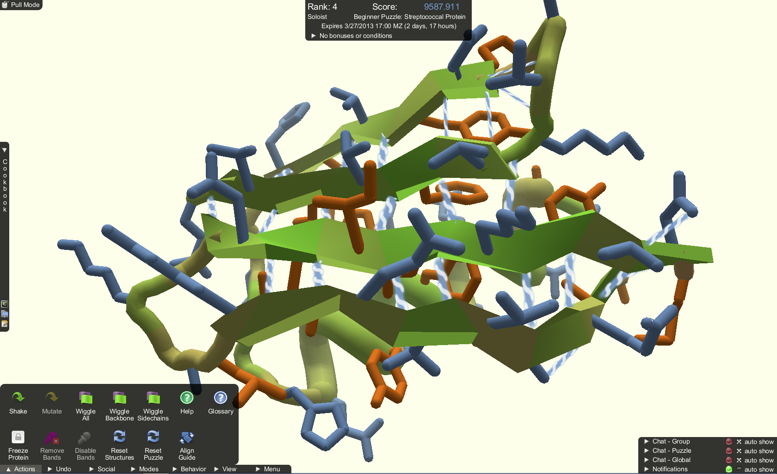
Complex Trading Cells

Slide 67
Features Of Platform
Data repository for simulation and validation
Real time trading environment
Graphic event-based scripting language
Historical and real-time statistics
Crowd based development environment
Competitions

Slide 68
Promotion
…new research…promising results.
We need to store wealth and require performing investment strategies.
We need to stabilize markets to reduce entropy.
…we can earn money and make the economic system more sustainable.

Slide 69
It would be great to work together!

Slide 70
Code Language
−Δx
Δx
2. OS
−Δx
1. OS
Δx
Intrinsic time
[t-events]
1
2
3
4
We use the events associated with a specific scaling law as triggers to initiate actions.
We use the directional change event operator plus overshoots to set the beat for the trades of trading atoms.
For example: Intrinsic time t-event 1….wait, 1st OS go short -0.25, 2. OS -0.25; intrinsic time t-event 2....no action, intrinsic time event 3: wait, 1st OS wait, 2nd OS go short -0.25

Slide 71
Why We Need To Ask Basic Questions?
Starting in 1985, we tested more or less every methodology…
Standard models work a little, but break down as soon as they become more complex or are combined: mantra of practitioners is to keep models simple and stupid.
Astronomy, computer technology, etc....have sophisticated models; so why not in finance and economics?
We need to rethink foundations and ask basic questions:
  In the spirit of relativity theory: is a financial market one deterministic system or is a financial market an output of a process of a large number of interacting systems?
  What is time?

Slide 72
What Type of Models Exist?
Technical models
  Oscillators
  Trend following
Fundamental models
  Regression models
What do they have in common?
What are the new ideas?

Slide 73
Quantitative Trading
Directional trading:
  Fundamental systems
  Universal systems
Intraday models
Equity statistical arbitrage:
  Technical strategies
  Fundamental strategies
Volatility arbitrage
Directional volatility

Slide 74
Underlying Issues
Starting date dependency

Slide 75
Featrues Not To Forget
80% of volume has duration of only 20 minutes
98% has intra-day duration
Agent diversification is essential!

Slide 76
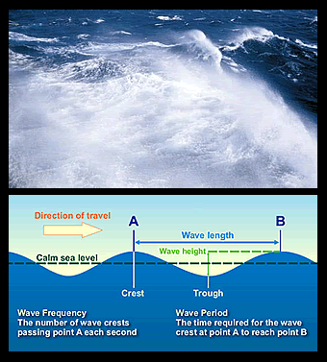
Featrues Not To Forget

Slide 77
What Is Time?
Linear and cyclical time in mythology
Philosophy of time
Newtonian time
Relativistic time
World time
Biological and psychological time
Transaction time
Event time…….

Slide 78
How Do We Experience Time?
Experience of time is personal: sleep, dreams, accidents, illness, mood, words, financial draw downs.
Market participants see the same time series differently, they have different filters, time horizons and frames of reference.
Market participants hear of political events at different times; sequence of events is ambiguous in financial markets.

Slide 79
FX Tick-By-Tick Data
A tick-by-tick data of 13 currency pairs:
  AUD-JPY (15'286'858), AUD-USD (7'037'203),
  CHF-JPY (17'081'987), GBP-CHF (27'141'146),
  GBP-JPY (26'423'199), GBP-USD (13'918'523),
  EUR-AUD (19'111'129), EUR-GBP (13'847'688),
  EUR-CHF (9'912'921), EUR-JPY (22'594'396),
  EUR-USD (13'093'081), USD-CHF (13'812'055),
  USD-JPY (13'507'173).
From Dec 1 2002, and Dec 1 2007
A simple Gaussian random walk made of one million ticks at every second:

Slide 80
Intrinsic Time
Uniform intrinsic time scale for a given reversal of x percent: X = (X_1, X_2, X_3 …. )
Events have equal weights in intrinsic time.
Events occur with a shift of x percent from extreme.
Intrinsic time scales with different thresholds are analogous to 1 minute, 1 hour, 1 day, etc. time scale.

Slide 81
Physical And Intrinsic Time
Physical time
e.g. [hours]
1
2
3
4
5
6
−Δx
−Δx
Δx
Δx
Intrinsic time
[t-events]
1
2
3
4

Slide 82
Dynamic Nature Of Intrinsic Time
Physical time
e.g. [hours]
1
2
3
4
5
6
Symmetric uncertainty of excursions at higher frequency than time grid
−Δx
−Δx
Δx
Δx
Intrinsic time
[t-events]
1
2
3
4
Asymmetric uncertainty of excursions conditional to intrinsic threshold

Slide 83
Why Do We Observe Scaling Laws?
Property Y
Observed Scaling Law
Central Limit Theorem
Event Operator: X
Conjecture 1: due to central limit theorem output of property y conditional to event filter X is a scaling law.
Conjecture 2: In network of interactions every ‘node or system’ has an associated grid of scaling laws that provide a frame of reference and determine its reactions.

Slide 84
Agent Based Modeling
Financial market consists of large network of interacting agents.
In our trading models we create networks of agents.
Agents are generic and are configured on the basis of the scaling law methodology.
Individual agents differ with respect to parameter settings and details of code configurations.
We develop models that are triggered by overshoots of t-events and are counter-trend models designed to stabilize markets.

Slide 85
Discussion
Point of departure:
Physical time scale is static and discards valuable information.
Proposal: introduce an event based time scale.
We define an event as a directional change or excursion of ≥ x percent from extreme.
Intrinsic time maps events of local extremes.
Results:
Discovery of large number of scaling laws (results can be verified with small data samples).
Intrinsic time scale:
  Intrinsic events are not equi-distant in physical time
  Events have fixed shift from local extreme; they are equi-distant from extreme and provide predictive information.
Notes:
85

Slide 86
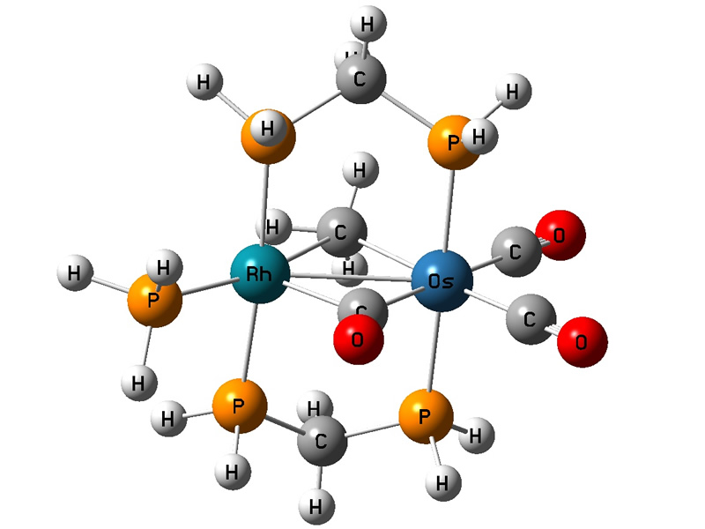
Financial Decision Trees
DNA is code language for instruction set at cell level
DNA is ubiquitous tool in nature to replicate and store information.
We use ‘events’ and ‘overshoots’ of scaling laws to define financial DNA.
Financial DNA is used to define complex behavior patterns of agents..

Slide 87
Example Of Financial DNA
We develop trading models as networks of coastline traders to diversify risk.
Decisions of individual coastline trader is defined by financial DNA.
Simple DNA setup:
  Intrinsic clock to increase positions
  Intrinsic clock to reduce positions
  NAV i-clock of agent to increase allocation
  NAV i-clock of agent to reduce allocation and take profit.

Slide 88
DNA Configuration
I-clock to increase positions (0.5%): overshoot 1…to 20; 1st overshoot establish position with gearing 0.1
2nd overshoot increase position by 0.05 gearing
3rd overshoot increase position by 0.05 gearing
Decisions of individual coastline trader is defined by financial DNA.
Simple DNA setup:
  Intrinsic clock to increase positions
  Intrinsic clock to reduce positions
  NAV i-clock of agent to increase allocation
  NAV i-clock of agent to reduce allocation

Slide 89
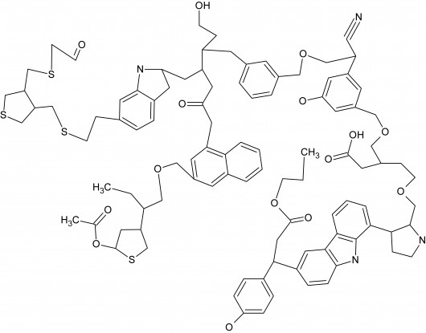
Complex Organic Matter

Slide 90
Unique
Intrinsic time
Original Price Curve
Threshold 0.8%
Price
Physical Time
Directional Change
Overshoot
DC
1. Overshoot
OS
Threshold
Price
Event Time
Threshold 0.2%
Threshold 0.4%
Intrinsic Time

Slide 91
Trading the Coastline
Notes:
Enhance picture

Slide 93
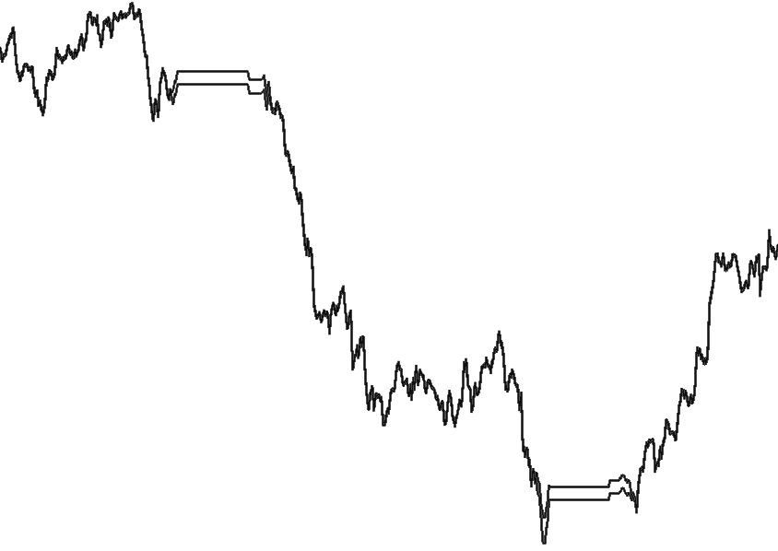
Unique
Inhouse Science And Research Drives Your Investment
1. Tick-by-Tick
2. Intrinsic Time
3. Scaling Laws
We collect up to 100‘000 data points per day per currency pair: more than one price update per second. The cumulative path travelled tick-by-tick provides a coastline with many ups and downs, a coastline that is 10x longer than the daily move.
Using intrinsic time, we can differentiate between overreacting (overshoots) and normal (directional change) movements of tick-by-tick price data. Intrinsic time zooms in on the dynamics of markets and allows us to act when something happens.
The scaling laws pervasive to tick-by-tick data when applying intrinsic time, provide consistent and unbiased statistical properties to the trading model. They unveil hidden patterns in FX tick data.
Directional Change
Overshoot
1. Overshoot
DC
OS
Price
Price
Physical Time
Event Time
^{Glattfelder et al.:} Quant. Financ. 11(4), 599 - 614 (2011)

Slide 94
Exciting Work…

Slide 95
Key Features Of FX Markets
FX spot transaction volume is 2 trillion per day, 15 percent of US GDP
Price ticks occur at irregular intervals.
Price changes are leptokurtic, increasingly so for short-term horizons.
Average volume per second is 12 million of buys and sells; volume spikes are two to three orders larger in size. Small imbalances of buy and sell volume have big price impact.
80% of volume has holding periods of less than 20 minutes; 98% of volume has holding periods of less than 24 hours.
Bid/ask spread can be as low as 0.0003%
Average price move per day is 0.5% with a daily 6.4% coast line of sum of price changes larger than 0.05% after deducting transaction costs.
Above features are typical for other liquid markets

Slide 96
Trading Models?
−Δx
−Δx
Δx
Δx
Intrinsic time
[events]
1
2
3
4
When do we go long or short?
Counter-trend strategies: it is too early to take counter-trend position at time of event, we need to manage risk according to size of overshoot.
We need to trade on two sets of intrinsic time scales: one to increase and another to reduce size of positions.
We use local data to measure exponents of scaling laws to estimate risk factors.

Slide 97
Summary
Implicit hypothesis: everything is based on interacting systems.
Intrinsic time is endogenous to a specific system.
Events are displacements from local extremes.
Event based methodology reveals many scaling laws.
Scaling laws establish proportional relationships between different variables or properties.
The scaling laws are a frame of reference for a new class of economic and financial models.
The concept of intrinsic time is by design relativistic and opens the door to a relativity theory of economics.
The real work has only just started, lots and lots of open questions.
Notes:
97

Slide 98
Global Challenges
Unemployment
Environment
Political discontent
Zero interest rate policy
System changers for global economy:
Global ledger based on Bitcoin peer-to-peer crypto technology
Predictive technology based on a relativity theory of economics.

Slide 99
How Far Does Price Overshoot?
Extremum
Directional Change
Overshoot
Directional Change

Slide 100
Directional Change and Overshoots: Endogenous Time Grid
Extremum
Directional Change
Overshoot
Directional Change
Event Time
Physical Time

Slide 101
Physical Time: Imposing Artificial Time Scale on Time Series
How to analyze time series:
Every tick?
Every second, minute, hour
Assumptions: data are equally spaced, homogenous

Slide 102
Physical Time: Imposing Artificial Time Scale on Time Series
Exogenous Time Grid
Physical Time

